Slide 1
SAVING FEDERAL TRAVEL DOLLARS
By Vigna Shree Telukunta

Slide 2
RESEARCH OVERVIEW

Slide 3
Introduction
■ Federal employees frequently travel to professional development conferences and training events
■ Travel costs associated with trainings constitute a huge portion of an agency’s budget
■ A method for evaluating travel costs and determining the least expensive conference site from over 261 US cities was developed using the shortest path problem
Notes:
Federal employees frequently travel to professional development conferences and training events and travel costs associated with trainings constitute a huge portion of an agency's budget. And this is why it is best to select the most cost effective training location among many possible choices.
So for example, suppose there is an annual women’s leadership conference with DoD every April. Instead of choosing a city that all of us would like to go to – for example, Honolulu, Colorado springs, or Seattle – it would probably be best to choose a city that would minimize travel and hosting expenses and remain within annual travel-budget constraints
To save tax payers money, a method for evaluating travel costs and determining the least expensive conference site from over 261 US cities was developed using the shortest path problem.
But before going into our approach, lets go over some assumptions that were made with these problem.

Slide 4
Transportation Assumptions
■ Those that are less than 100 statute miles away will drive to the destination city using the standard $.325 cents per mile rate
■ Those that are more than 100 statute miles away will fly
■ Cost is based off a GSA-negotiated fare on one-way flights that can be used bidirectionally
■ All travel is done individually (no ride or room sharing)
■ The GSA-contracted airfare is available for all flights.
Notes:
This means that if the conference was in Richmond, I will need to drive my own vehicle and will be reimbursed $.325 cents per mile which is a maximum of $32.50 for a one way trip. But if the conference was in Nashville, I would be expected to fly.
This means that I am paying for 2 1 way flights instead of a round trip flight since the GSA does have annual fixed rate contracts with airlines

Slide 5
Per-Diem Assumptions
■ Used to pay for meals and incidental expenses. These are geographically dependent and are paid at a flat rate for each full day
■ For travel days, 75% of per-diem rates are reimbursed
– If flying, per-diem rate is for 4.5 days. Participants will arrive day prior to conference and will depart on the last day
– If driving, per-diem rate is for 3.5 days. Participants will arrive day of the conference and will depart on the last day
■ No government meals available
■ When Per-Diem rate is not available, rate is $85 per day

Slide 6
Lodging Assumptions
■ Set rates are temporally and geographically dependent. If there is a seasonal per-diem rate, the high season rate is used regardless of the time of year
■ No government lodging available

Slide 7
Research Problem
■ Using the shortest path problem, find the optimal city that should host the conference because location impacts travel cost - depending on the number of participants and their originating location.

Slide 8
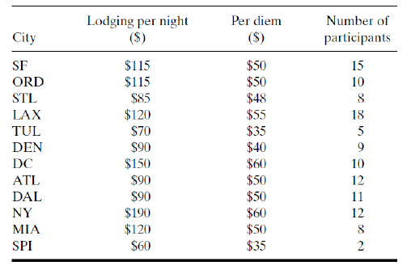
Costs
Notes:
Key things to note is that lodging in NY is $190 and lodging in SPI is $60
Per Diem for New York is $60 and lodging in SPI is $35.
There are more participants flying from LAX and only 2 participants from SPI.

Slide 9
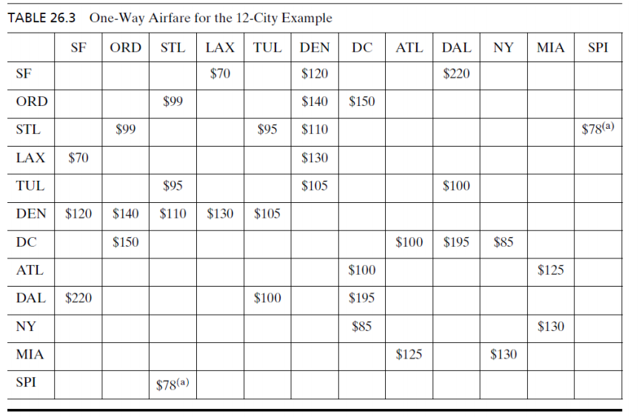
Airfare

Slide 10
APPROACH TO SOLUTION

Slide 11
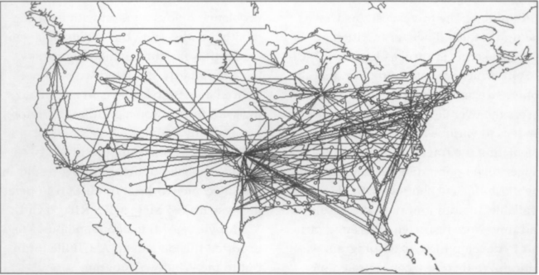
Possible Approaches to Solution
Dijkstra's Algorithm
Floyd Warshall Algorithm
A* Search Algorithm

Slide 12

Python Code

Slide 13
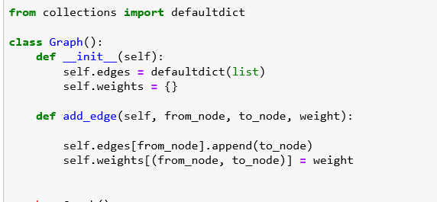
Creating Graph

Slide 14
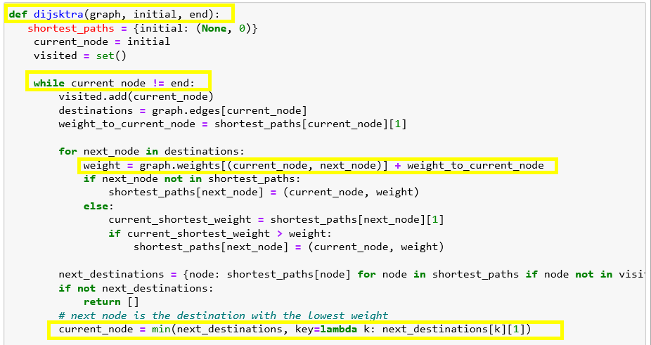

Slide 15
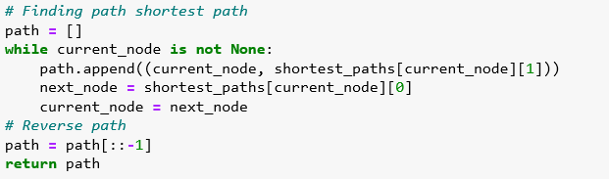

Slide 16
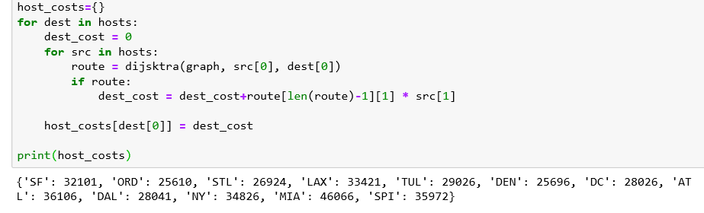

Slide 17
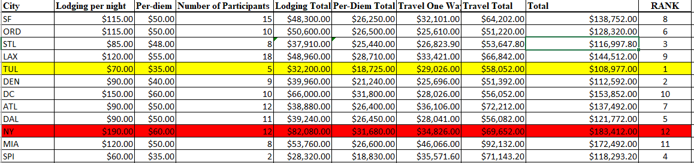
Optimal Location
Values calculated by code:

Slide 18
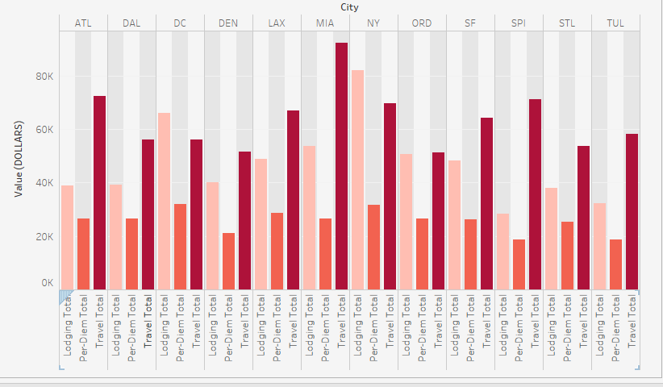

Comparing constraint values

Slide 19
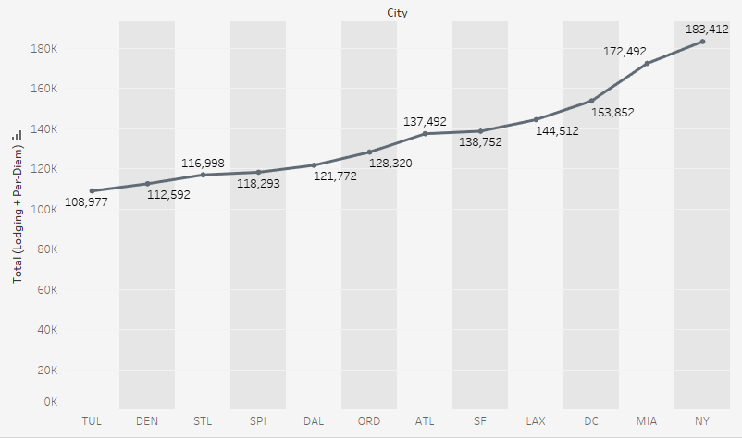
Graphical Representation

Slide 20
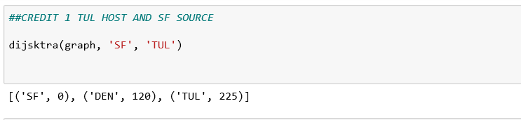
Extra Credit 1:
Given that TUL is the chosen host city, how should reservations be made for SF participants?

Slide 21
Arrangements for SF participants
Travel cost (two way fair) = $225 * 15*2 = $6750
Lodging cost = $70 * 15 * 4 = $4200
Per-diem cost = $35*15* 4.5 = $2362.50
Total cost = $9937.50

Slide 22
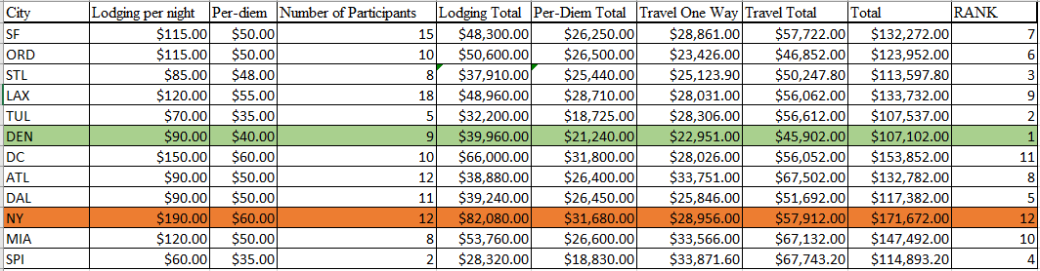
Extra Credit 2:
Suppose that the following new air links are added to the of admissible routes; ORD-NY ($150), LAX-MIA ($300), DEN- DAL ($110), ATL-NY ($150). Determine the host city.

Slide 23
Top 5 Cities to Host Conference:
Rank | Place | Cost | Difference
1 | TUL | $108,997.00 | $0.00
2 | DEN | $112,592.00 | $3,615.00
3 | STL | $116,997.80 | $8,000.80
4 | SPI | $118,293.20 | $9,316.20
5 | DAL | $121,772.00 | $12,795.00

Slide 24
Top 5 Cities to Host Conference
After Adding New Links
Rank | Place | Cost | Difference
1 | DEN | $107,102.00 | $0
2 | TUL | $107,537.00 | $435.00
3 | STL | $113,597.80 | $6459.80
4 | SPI | $114,893.20 | $7,791.20
5 | DAL | $117,382.00 | $10,280.00

Slide 25
Conclusion
■ Seasonal lodging and using the highest
■ Per-diem rate not listed for all cities (find those that are $85)
■ This is a good model but could be better

Slide 26
References
Informs - Saving Federal Travel Dollars
http://benalexkeen.com/implementing-djikstras-shortest-path-algorithm-with-python/

